Slide 1




Fraud Detection Project
By: G-1 Team

Slide 2


Slide 3

G-1 Team Members
Ammar Alhawashem
Maram Alzahrani
Noof Alsafi
Taif Alzahr
Sara
Noura Alajmi
Hibah Sindi
Shahad Ali
Reema Almeshal
Raya

Slide 4

Outlines:
Project Overview
Data Analysis and Visualization
Predictive Model
Logistic Regression model
RF model
XG Boost model
Neural Network
Model Deployment
Conclusion

Slide 5

Project Overview

Slide 6

Problem Statement
Detect fraudulent credit card transactions using a dataset containing information about transactions made by European cardholders over two days.

Slide 7

Goal
The primary goal of this project is to design and implement a robust machine learning model to reduces false alarms while effectively identifying instances of fraud. The ultimate objective is to provide financial institutions with a dependable tool to enhance fraud prevention strategies and safeguard customers' financial security.

Slide 8
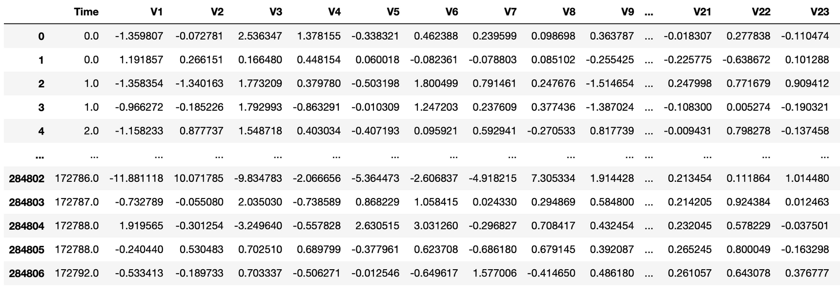

Dataset
The dataset contains credit card transaction records from September 2013, featuring 284,807 transactions. Within this dataset, only 492 instances (0.172%) represent fraudulent activities, making it highly imbalanced.

Slide 9

Data Analysis and Visualization
2
Notes:
where it can classify new images based on their textual descriptions without the need for explicit training on specific image classes.

Slide 10
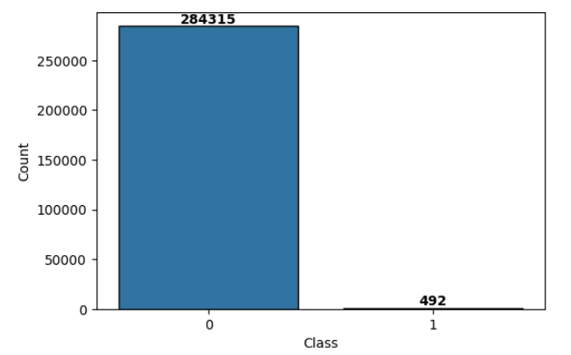

Fraud distribution
2
Notes:
where it can classify new images based on their textual descriptions without the need for explicit training on specific image classes.

Slide 11
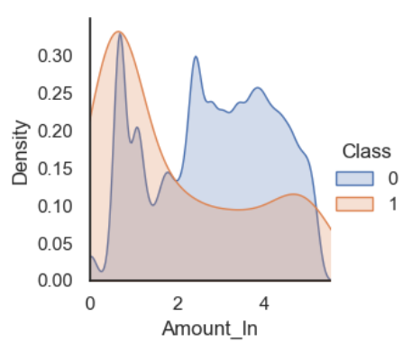
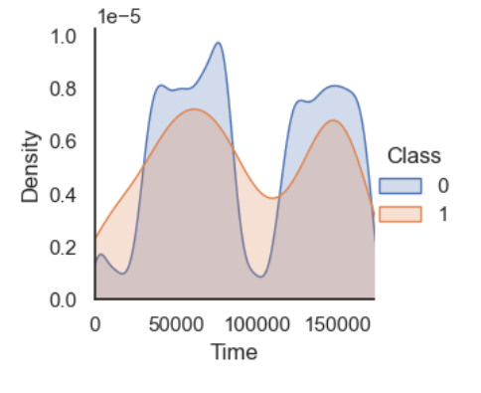
Kernel Density Estimation of Transformed Features (Amount and Time)
2
Notes:
where it can classify new images based on their textual descriptions without the need for explicit training on specific image classes.

Slide 12
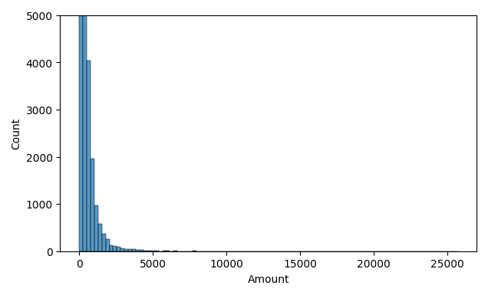
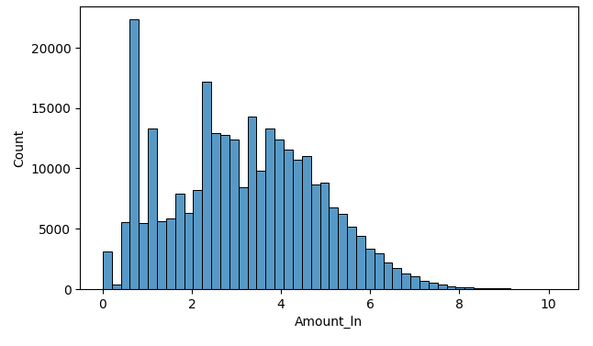
Amount before and after transformation
2
Notes:
where it can classify new images based on their textual descriptions without the need for explicit training on specific image classes.

Slide 13
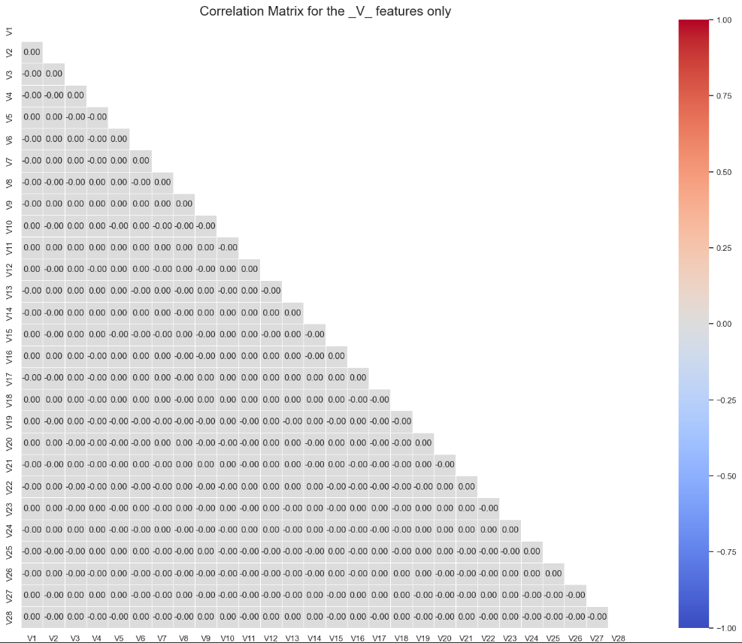
Features Correlation
2
Notes:
where it can classify new images based on their textual descriptions without the need for explicit training on specific image classes.

Slide 14
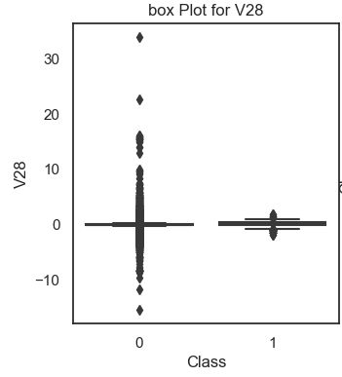
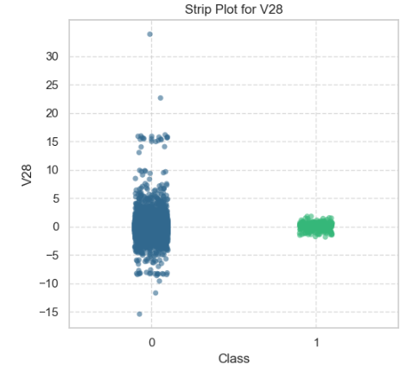
Are they outliers?
2
Notes:
where it can classify new images based on their textual descriptions without the need for explicit training on specific image classes.

Slide 15

Predictive Model
Notes:
In Linear Algebra, one common way to measure if two vectors are of similar characteristics (they are like each other) is to calculate their dot product (multiplying the matching entries and take the sum of them); if the final number is big, they are alike and if it is small they are not (relatively speaking)!

Slide 16
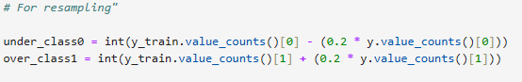
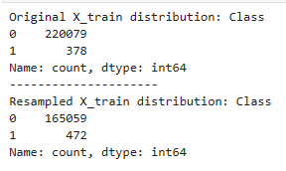
Over/Under Sampling
Notes:
In Linear Algebra, one common way to measure if two vectors are of similar characteristics (they are like each other) is to calculate their dot product (multiplying the matching entries and take the sum of them); if the final number is big, they are alike and if it is small they are not (relatively speaking)!

Slide 17
Predictive Model Building
Classification algorithms we applied:
Logistic Regression
Random Forest Classifier
XGBoost Classifier
Neural Network
Notes:
In Linear Algebra, one common way to measure if two vectors are of similar characteristics (they are like each other) is to calculate their dot product (multiplying the matching entries and take the sum of them); if the final number is big, they are alike and if it is small they are not (relatively speaking)!

Slide 18
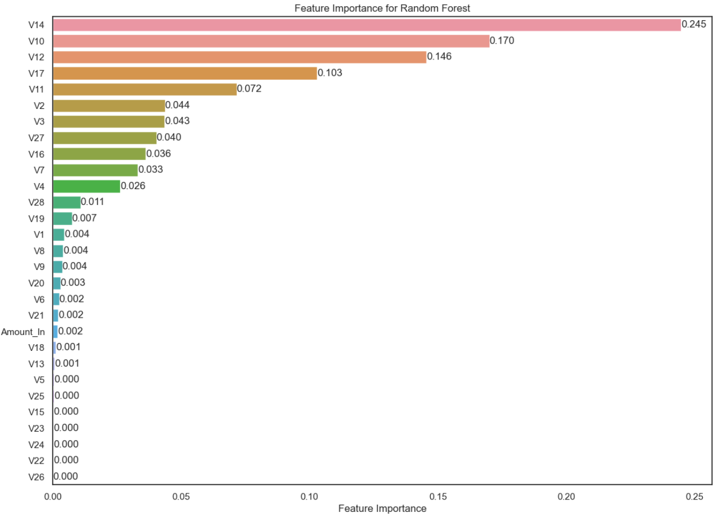
Features Importance for the Best Model
Notes:
In Linear Algebra, one common way to measure if two vectors are of similar characteristics (they are like each other) is to calculate their dot product (multiplying the matching entries and take the sum of them); if the final number is big, they are alike and if it is small they are not (relatively speaking)!

Slide 19

Model Deployment
Notes:
In Linear Algebra, one common way to measure if two vectors are of similar characteristics (they are like each other) is to calculate their dot product (multiplying the matching entries and take the sum of them); if the final number is big, they are alike and if it is small they are not (relatively speaking)!

Slide 20
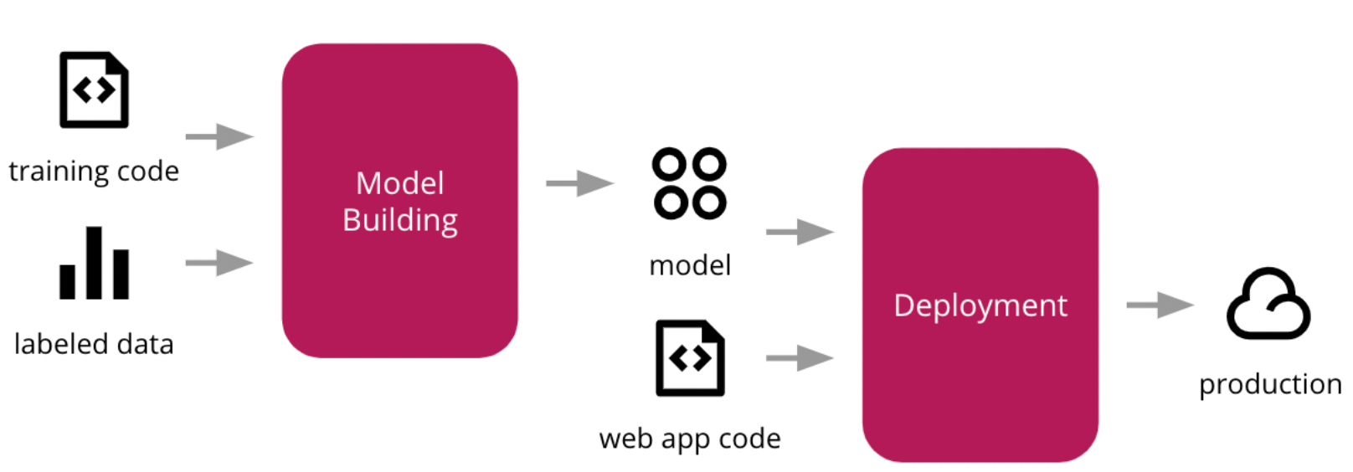
What is Model Deployment?
Deployment means putting a machine learning model into action in a real business setting to make decisions based on data. It's one of the last steps in the machine learning process.
In this project we deployed our ML model with Streamlit on AWS.

Slide 21
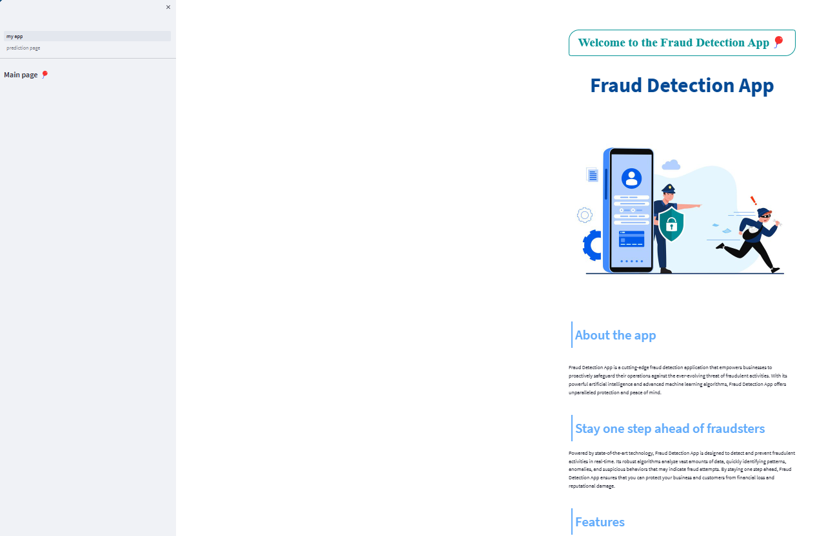
Fraud Detection App
Page 1

Slide 22
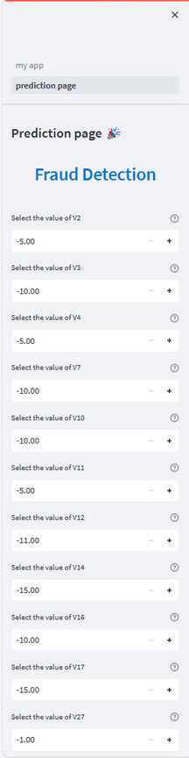
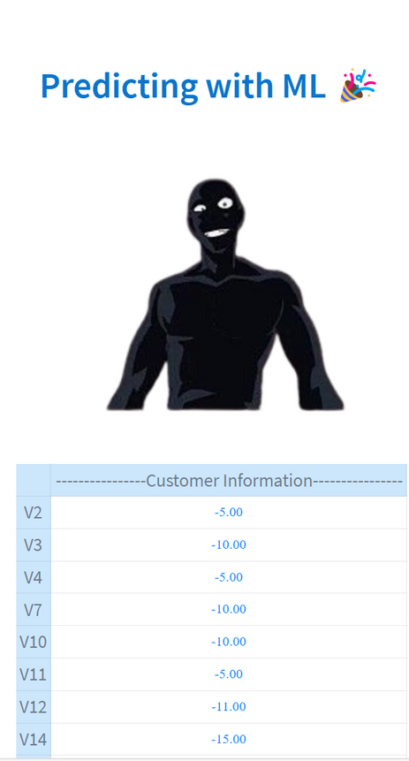
Fraud Detection App
Page 2

Slide 23
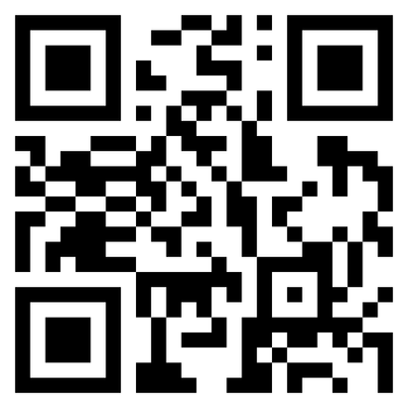

Visit Our App
URL

Slide 24

Conclusion
Notes:
In Linear Algebra, one common way to measure if two vectors are of similar characteristics (they are like each other) is to calculate their dot product (multiplying the matching entries and take the sum of them); if the final number is big, they are alike and if it is small they are not (relatively speaking)!

Slide 25

In this project, we deploy a Streamlit app that detects transaction Fraud based on user inputs. The app loads a trained Random Forest classifier model and applies it to the user input data to detect whether or not the transactions is likely to Fraud.
Notes:
In Linear Algebra, one common way to measure if two vectors are of similar characteristics (they are like each other) is to calculate their dot product (multiplying the matching entries and take the sum of them); if the final number is big, they are alike and if it is small they are not (relatively speaking)!

Slide 26

Thanks for Listening

